Slide 1
Imputation Methodolgy and Explanation

Slide 2
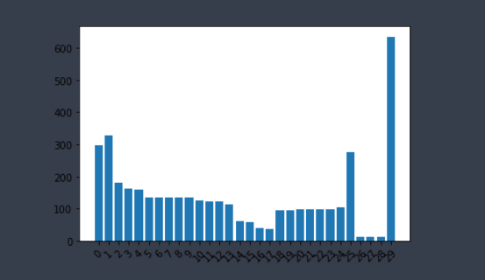
Missing Format: Years 1990-2000 have the most missing data throughout all the files. Extrapolation reasonable
Number of NaN values by year (aggregated all files)
1990
2019

Slide 3
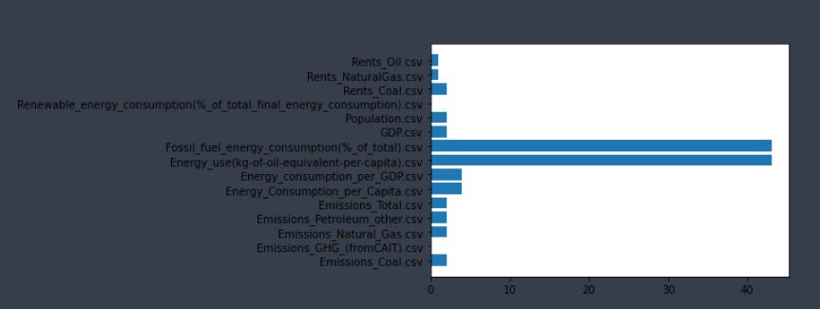
Missing Format: Countries which have more than half their data missing by file used. KNN better suited for these
Count of countries with 15 or more NaN entries by file

Slide 4
Solution:
Given their Advantages and disadvantages we used a mix of Regression and KNN Imputation.
Countries with more than half their data as NaN will use KNN, while those with fewer missing data on the tail ends benefit from Polynomial Regression.
To avoid overfitting with Regression, we add a noise (normally distributed st. dev of the available country data)
Note: Each Country has their own regression line fit specifically to them, so we are fitting a model for each of 167 countries for all 15 different csv files.

Slide 5
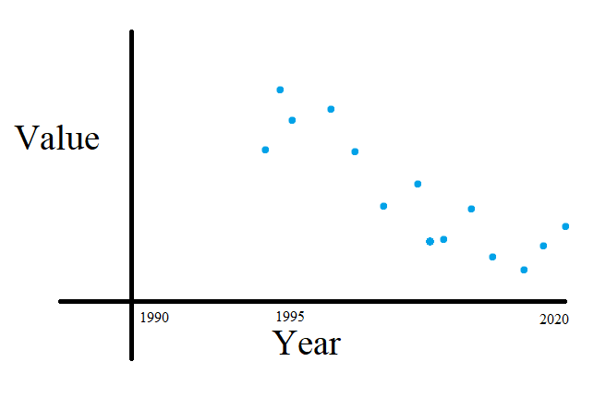
Given data: Assume 1990-1994 is missing

Slide 6
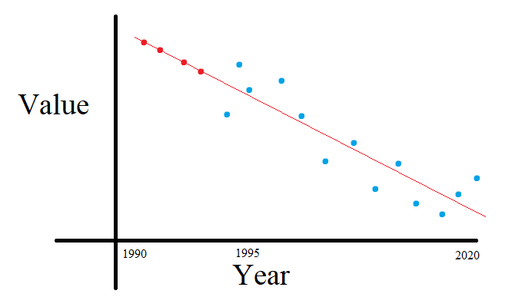
Given data: Linear Regression - Good

Slide 7
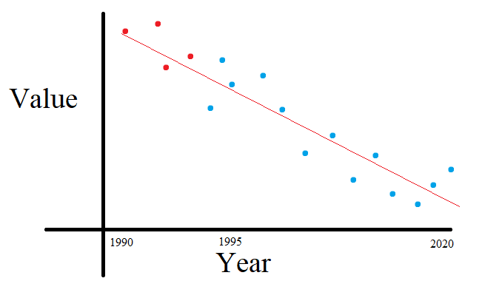
Given data: Linear Regression with noise - Better

Slide 8
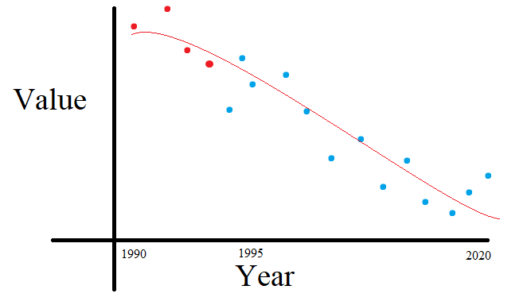
Given data: Polynomial Regression with noise - Best
More specifically, 3rd degree polynomial as it outperformed 2nd deg

Slide 9
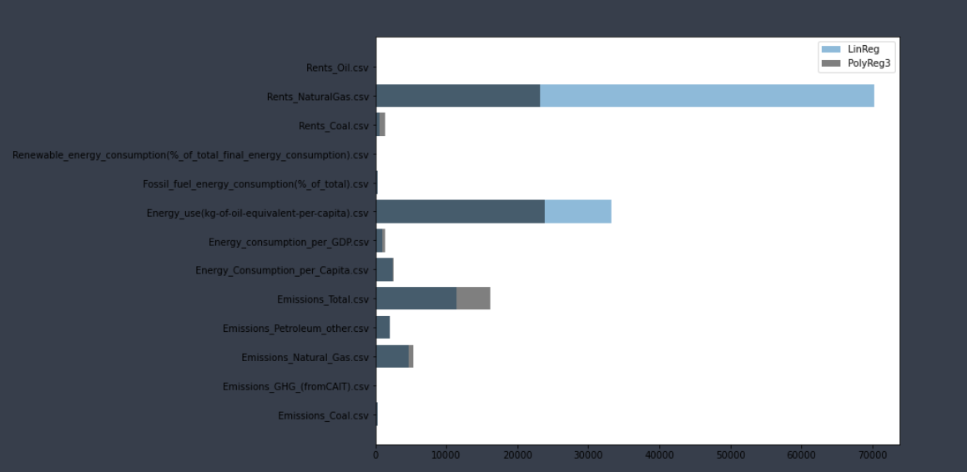
Comparing Errors between Linear and 3rd degree Polynomial Regressions
Mean Absolute Error for the two models
Low error is from files with no/little missing data

Slide 10
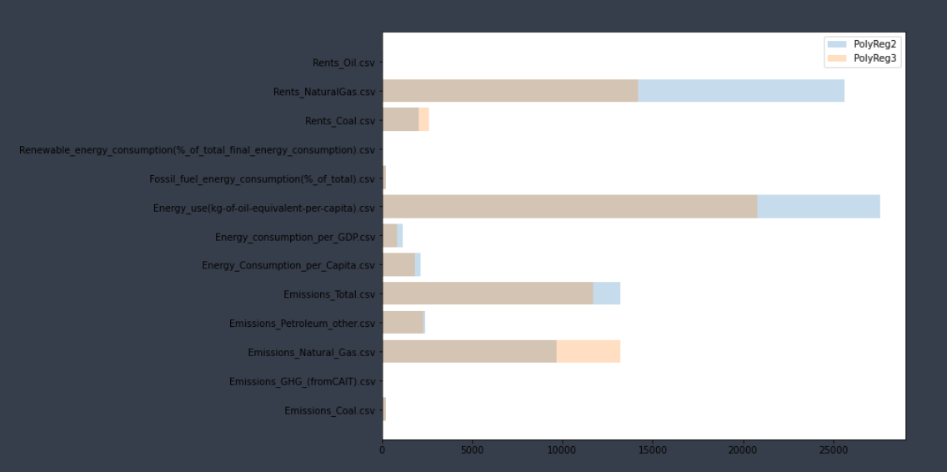
Comparing Errors between 2nd and 3rd degree Polynomial Regressions
Mean Absolute Error for the two models
Low error is from files with no/little missing data

Slide 11
Questions:
Last Year they reduced all 20 years they considered into 1 single

